Slide 1

Individual Household Electric Power Consumption
Ibrahim Elsayed

Slide 2
Electric Power Consumption
What is the Electric Power Consumption case?
Analyzing and predicting household energy usage patterns to optimize consumption and ensure efficient energy management.
Importance in the electrical industry?
It aids in demand forecasting, load management, energy efficiency, and integrating renewable energy, ensuring grid stability and cost savings.
Dataset used:
Individual Household Electric Power Consumption from the UCI Machine Learning Repository.
The data gathered in a house located in Sceaux (7km of Paris, France) between December 2006 and November 2010 (47 months).
Objective of the analysis:
Understand energy usage patterns, forecast demand.

Slide 3
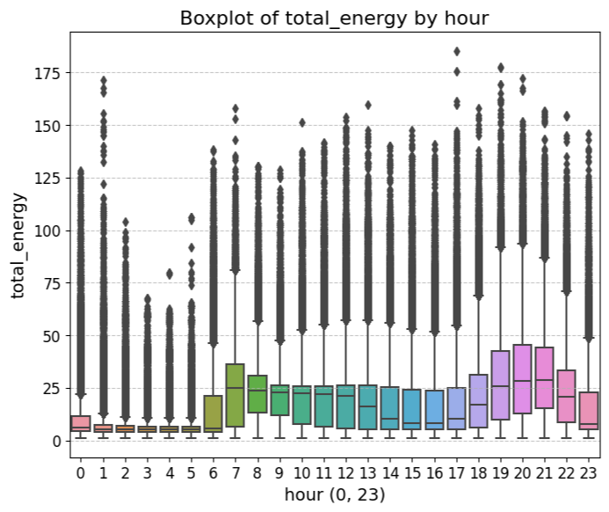

EXPLORATORY DATA ANALYSIS
Target variable: Represents the total consumption of energy per minute with equation ($\text{global} \text{active} \text{power} \text{∗} \text{1000} \text{/} \text{60 − }\text{active} \text{energy} \text{machines} \text{in} \text{households}\text{ (}\text{dishwasher}\text{, }\text{washing} \text{machine}\text{, ..}\text{etc}\text{)}$ in watt).
Key Findings:
Time of Day: Consumption peaks during early
morning and evening hours, aligning with typical
household activities.

Slide 4
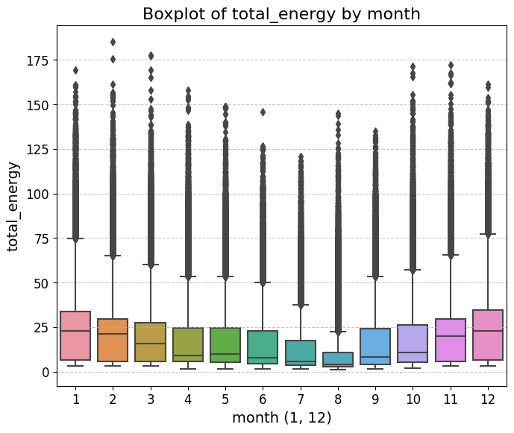
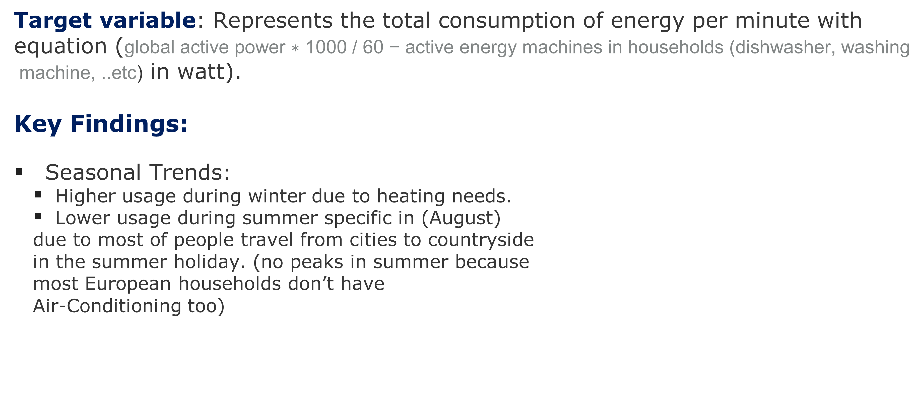
EXPLORATORY DATA ANALYSIS
Target variable: Represents the total consumption of energy per minute with equation ($\text{global} \text{active} \text{power} \text{∗} \text{1000} \text{/} \text{60 − }\text{active} \text{energy} \text{machines} \text{in} \text{households}\text{ (}\text{dishwasher}\text{, }\text{washing} \text{machine}\text{, ..}\text{etc}\text{)}$ in watt).
Key Findings:
Seasonal Trends:
Higher usage during winter due to heating needs.
Lower usage during summer specific in (August)
due to most of people travel from cities to countryside
in the summer holiday. (no peaks in summer because
most European households don’t have
Air-Conditioning too)

Slide 5
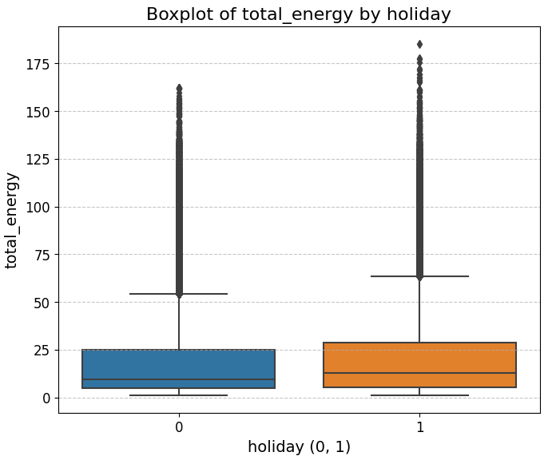
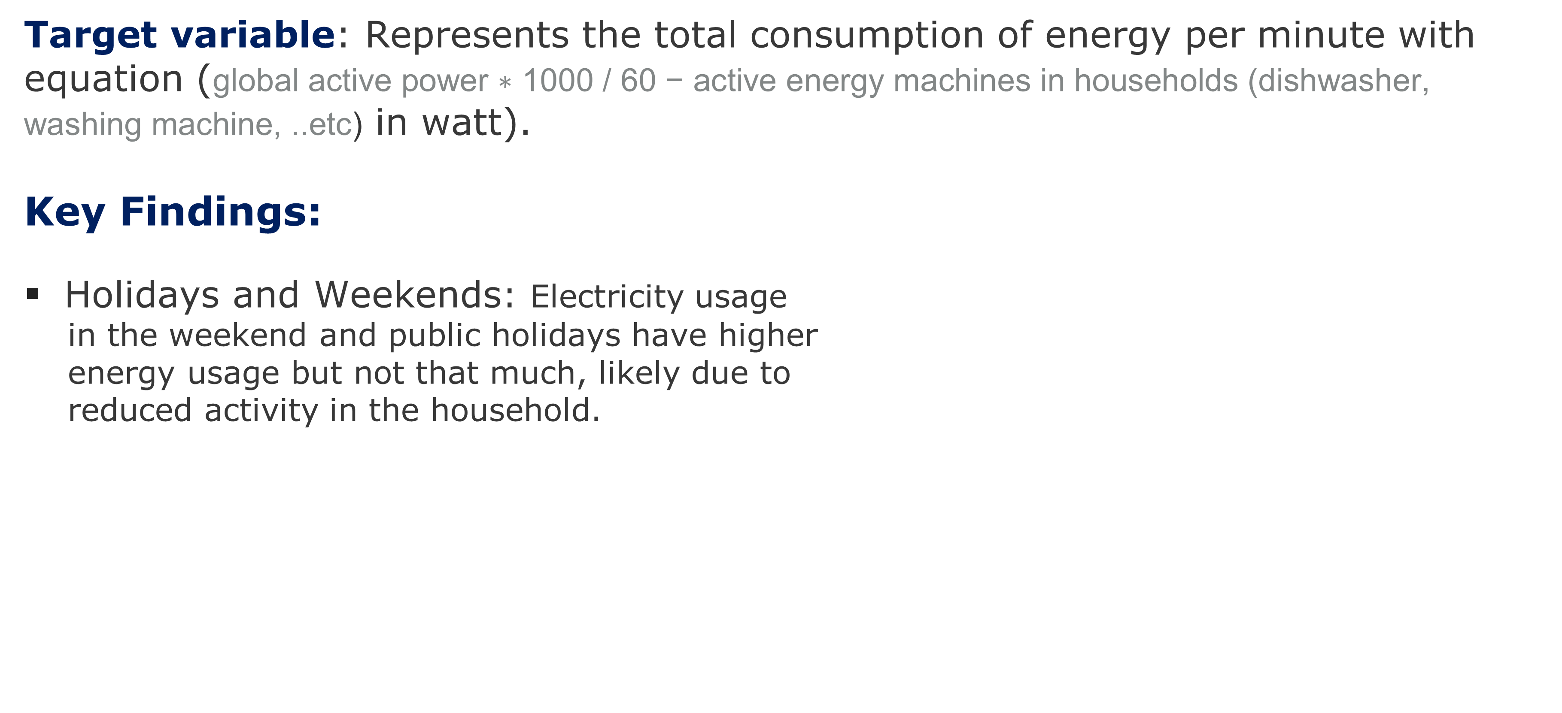
EXPLORATORY DATA ANALYSIS
Target variable: Represents the total consumption of energy per minute with equation ($\text{global} \text{active} \text{power} \text{∗} \text{1000} \text{/} \text{60 − }\text{active} \text{energy} \text{machines} \text{in} \text{households}\text{ (}\text{dishwasher}\text{, }\text{washing} \text{machine}\text{, ..}\text{etc}\text{)}$ in watt).
Key Findings:
Holidays and Weekends: Electricity usage
in the weekend and public holidays have higher
energy usage but not that much, likely due to
reduced activity in the household.

Slide 6
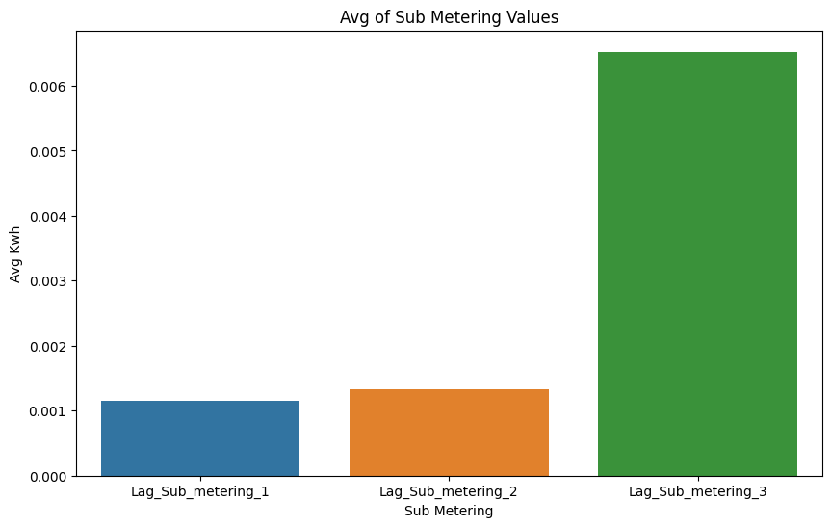
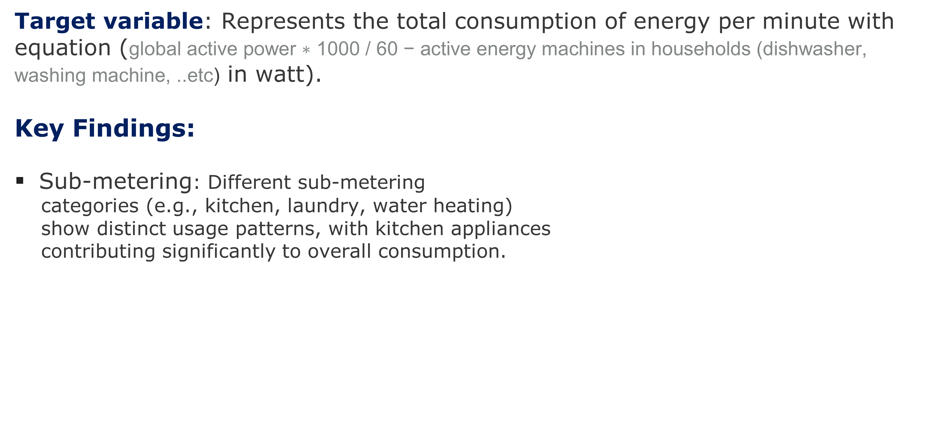
EXPLORATORY DATA ANALYSIS
Target variable: Represents the total consumption of energy per minute with equation ($\text{global} \text{active} \text{power} \text{∗} \text{1000} \text{/} \text{60 }\text{− }\text{active} \text{energy} \text{machines} \text{in} \text{households}\text{ (}\text{dishwasher}\text{, }\text{washing} \text{machine}\text{, ..}\text{etc}\text{)}$ in watt).
Key Findings:
Sub-metering: Different sub-metering
categories (e.g., kitchen, laundry, water heating)
show distinct usage patterns, with kitchen appliances
contributing significantly to overall consumption.

Slide 7
Methodology
Data Collection
Dataset fetching and Data Exploration
Data Preprocessing
Handling Missing Values: After Analyzing the distribution of each month - day of the week – hour the distribution varies from one to another so the best solution is to fill the missing values with the most same recent minute
Outliers: cap the outliers using the IQR technique with the max and min values because the features are skewed. As the data contains many factors depending on the time feature (seasons, holidays, some trends during days, ..) and after EDA the cap will be aggregated for each month, day of week, and hour.
Feature Engineering:
Created target variable and lag features for power consumption metrics.
Extracted features like season, holiday, day_of_week, and year.

Slide 8
Methodology ..con
Model Selection: XGBoost
Reason: XGBoost is used for modeling due to its high performance, It excels in handling large datasets efficiently, providing regularization techniques, handling the collinearity between features, and leveraging ensemble learning
Downside: Tree models have a downside when dealing with regression problems if the scale is becoming larger so, just ensure to monitor the model after the production stage.
Hyperparameter Tuning: Bayesian optimization was used to fine-tune the model's hyperparameters with time series cross-validation.
Train-Test Split: The dataset was split into training (90%) and testing (10%) sets to evaluate model performance.

Slide 9
Model Performance
Evaluation Metrics used: Mean Absolute Error
Comparing between before and after hyper parameter tuning and cross validation
 | Before | After
MAE on train | 1.40 | 1. 41
MAE on test | 1.18 | 1.16

Slide 10
Recommendation for Energy Company
Demand Forecasting:
Use the predictive model to forecast future electricity consumption, enabling better resource allocation and grid management.
Incorporate external factors like weather data to further improve forecast accuracy.
Energy Efficiency Programs:
Target high-consumption areas (e.g., kitchen appliances) with energy efficiency initiatives to reduce overall usage.
Customer Insights:
Provide customers with personalized insights into their consumption patterns, encouraging energy-saving behaviors.
Data Quality Improvements:
Address missing data and outliers more systematically in future data collection efforts to enhance model performance.

